Slide 1
Hymns For Worship
0
0
0
0
0
Scripture Reading: 1 Corinthians 15:20-28

Slide 3
“I AM” the
RESURRECTION
John 11

Slide 4
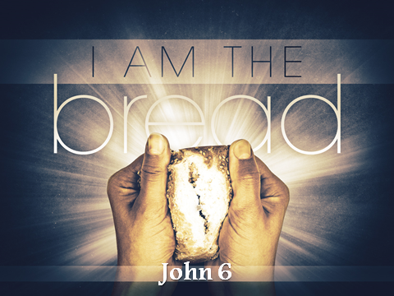

Slide 5
John 10:39 – Some sought to arrest Him
John 10:42 – Some sought to follow Him
John 11:1-44
The Death of Lazarus

Slide 6
John 11:4 – “This illness does not lead to death. It is for the glory of God, so that the Son of God may be glorified through it.”
John 9:3 – Man born blind
Opportunity To Glorify God

Slide 7
How was this time different?
Matthew 9:18-26 – The ruler’s daughter
Luke 7:11-17 – Widow of Nain’s son
John 11:6 – He waits 2 days longer
John 11:17 – Lazarus has been dead 4 days
John 11:39 – They feared the odor
Opportunity To Glorify God

Slide 8
John 11:23 – “Your brother will rise again.”
John 11:25-26 – “I am the resurrection and the life. Whoever believes in me, though he die, yet shall he live, and everyone who lives and believes in me shall never die. Do you believe this?”
“I Am” the Resurrection

Slide 9
“I AM” the
RESURRECTION
1 Corinthians 15

