Slide 1
THE
GOSPEL

Slide 2
A Problem In Galatia
Galatians 1:1-11
Galatians 6:12-16
They Were Accepting A Different Gospel

Slide 3
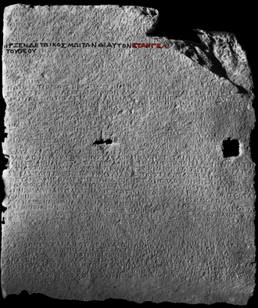
What Is the Gospel?
Answer #1 – “the death, burial, resurrection of Jesus.”
1 Corinthians 15:1-4
Answer #2 – “the Good News”
1 Corinthians 15:1-28
Colossians 1:15-20

Slide 4
Obeying the Gospel
It Is A Biblical Phrase
Romans 10:16
2 Thessalonians 1:8
1 Peter 4:17
Vengeance Against
Those Who Don’t Know God
Those Who Don’t Obey The Gospel

Slide 5
THE
GOSPEL

