Slide 2
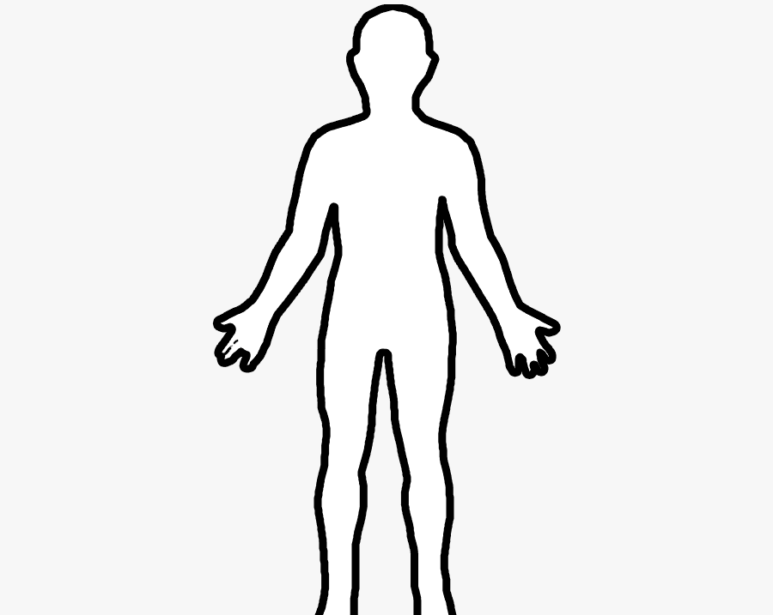
Approaching This Topic Objectively
“Is there a biblical provable pattern of public modesty requirements for men and women alike regardless of culture or situation?”

Slide 3
Pre-Law of Moses
Genesis 2-3
“garments” - ‘kethoneth’
A Tunic; Coat; Garment

Slide 4
Law of Moses
Exodus 28:40-43
From the Hip to the Thighs
Exodus 20:25-26
Mindful of Compromise

Slide 5
Law of Christ
1 Timothy 2:9-10
Proper
Clothing
Modesty
Self-Control
Godliness

Slide 6
Law of Christ
1 Timothy 2:9-10
Modesty: “a sense of shame or honor, modest, bashfulness, reverence, regard for others, respect; the state of being unassuming, intended to avoid impropriety or indecency.”

Slide 7
Law of Christ
1 Timothy 2:9-10
Modesty: “a sense of shame or honor, modest, bashfulness, reverence, regard for others, respect; the state of being unassuming, intended to avoid impropriety or indecency.”

