Slide 1
2022

Slide 2
Joshua 1 – God Commissions Joshua
Joshua 2 – Rahab Hides the Spies
Joshua 3 – Israel Crosses the Jordan
Joshua 4 – 12 Memorial Stones
Joshua 5 – Covenant Renewed
Joshua 6:1-21
THE CONQUEST BEGINS

Slide 3
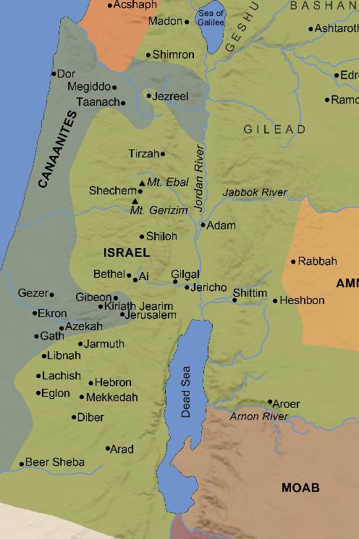
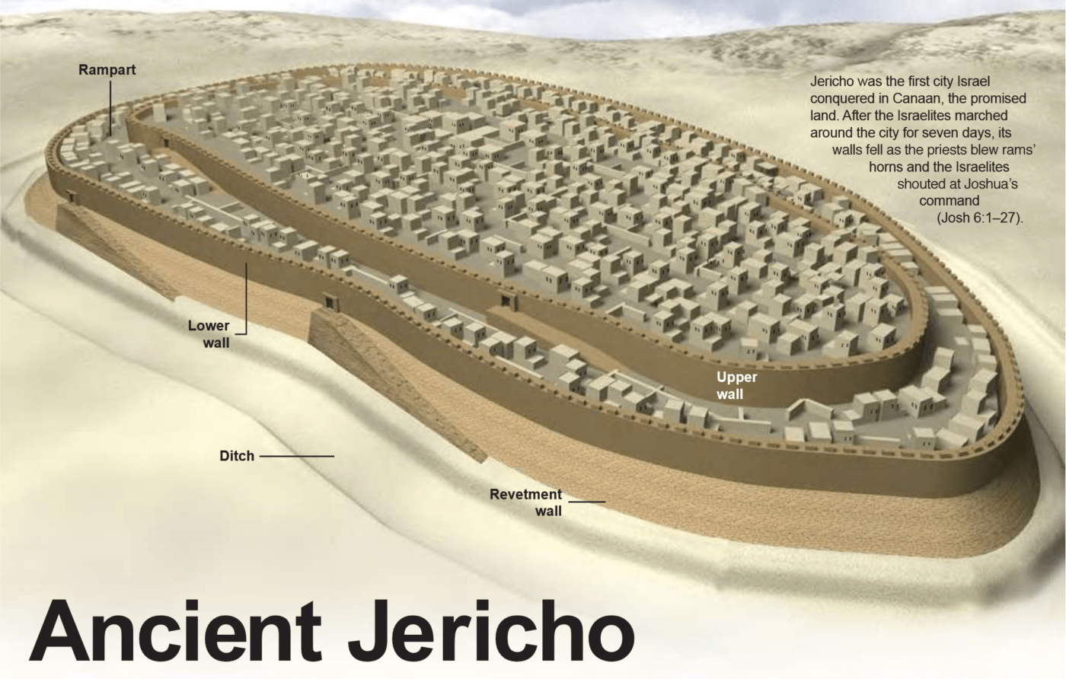
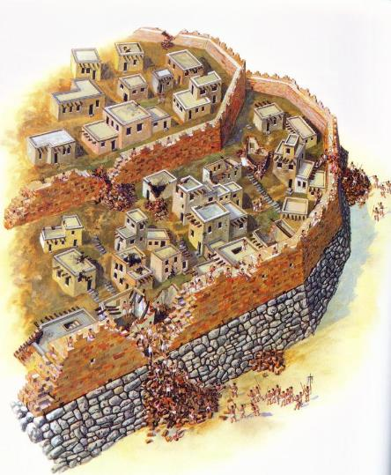
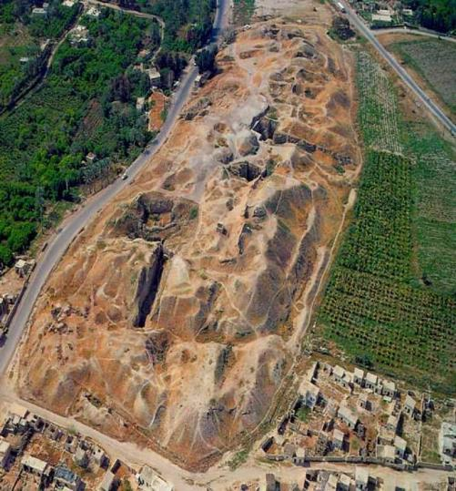
THE WALLS OF JERICHO

Slide 4
Walls Torn Down: The Walls of Jericho
Walls Torn Down: New Beginnings (Rahab)
Walls Torn Down: Walls of Doubt
Walls Torn Down: With God’s Help
Walls Torn Down: Details Matter
Walls Torn Down: Sin Results In Defeat
Walls Torn Down: Self-Reliance
Walls Torn Down: Conformity
Walls Torn Down: Pride
Walls Torn Down: Anxiety
Walls Torn Down: Uncertainty
Walls Torn Down: Despair
2 Corinthians 10:3-5
Hebrews 11:30
“By faith the walls of Jericho fell down after they had been encircled for seven days.”
2022

Slide 5
2022

