Slide 1
MODESTY
FROM WITHIN
1 Timothy 2:8-10

Slide 2
The Source of Modesty
1 Timothy 2:8-10
“First of all, then, I urge that supplications, prayers, intercessions, and thanksgivings be made for all people, for kings and all who are in high positions, that we may live a peaceful and quiet life, godly and dignified in every way.” (v.1-2)

Slide 3
The Source of Modesty
V.8 – “lifting holy hands”
This describes an attitude of prayer a humble and submissive attitude.
The idea of approaching God in a pure and holy manner

Slide 4
The Source of Modesty
V.9 – “Likewise” or “In like manner”
The core of modesty isn’t external…it’s in the heart
Can’t always judge internal by external
Matthew 23:5
But…it can reflect it
Matthew 15:17-20
Matthew 12:33

Slide 5
The Source of Modesty
“Modesty is a character trait, not a fashion state.” (Mark Broyles)
1 Peter 3:3-6 – Modesty is from within.

Slide 6
What Modesty Means
1 Timothy 2:9
Adorn: To put in order
Modest Apparel: Refers to the clothing
Modesty & Propriety: shamefacedness
Moderation: Good sense, self-restraint

Slide 7
What Modesty Means
Propriety:
Modesty which is ‘fast’; rooted in character.
Having regard for others; restraint from an unworthy act.
Luke 11:8 – opposite

Slide 8
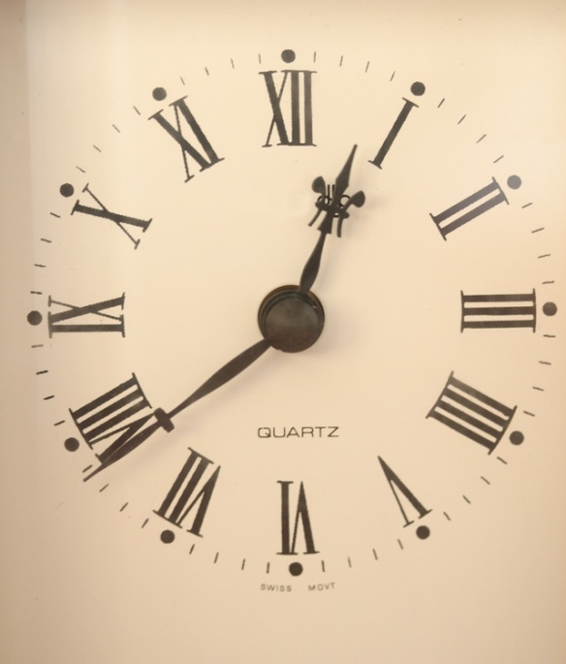
The Purpose of Modesty
1 Timothy 2:10 – “But with what is proper for women who profess godliness – with good works.”
Preparing The Body
Preparing The Heart

Slide 9
MODESTY
FROM WITHIN
What Are You Professing?

