Slide 2
Who Was Amos?
Amos 7:14-15 – A Shepherd & Farmer
Amos 1:1 – From Tekoa

Slide 3
What Was Going On with God’s People?
Amos 6:1-6
They were experiencing prosperity!

Slide 4
God’s Judgment Against Nations
God Would Judge “Worse” Nations
Amos 1:2-2:3
God Would Judge “Better” Nations
Amos 2:4-5
God Would Judge Their Nation
Amos 2:6-16

Slide 5
God’s Reasons for Being Angry
God Was Angered By Greed & Injustice
Amos 4:1 Amos 5:7, 12
God Was Angered By Hypocritical Worship
Amos 4:4-5 Amos 5:21-24
God Was Angered By Arrogance
Amos 6:4-6 Amos 6:7-8

Slide 6
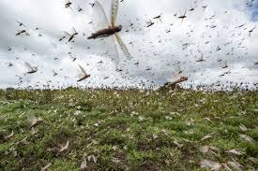
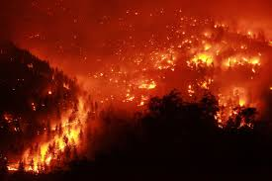
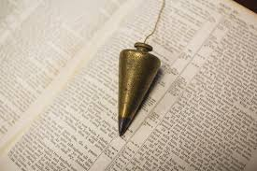
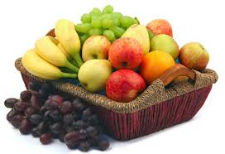
God’s Emotion In 4 Pictures
7:1
7:4
7:7
8:1

