Slide 1
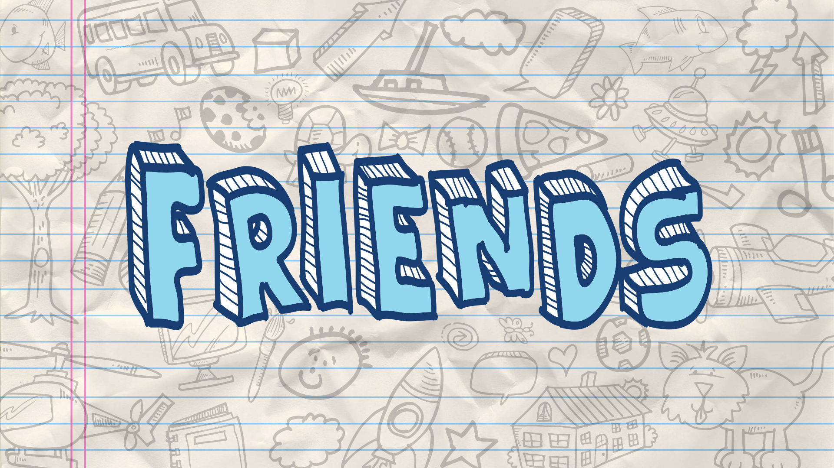
Who You Hang With Matters

Slide 2
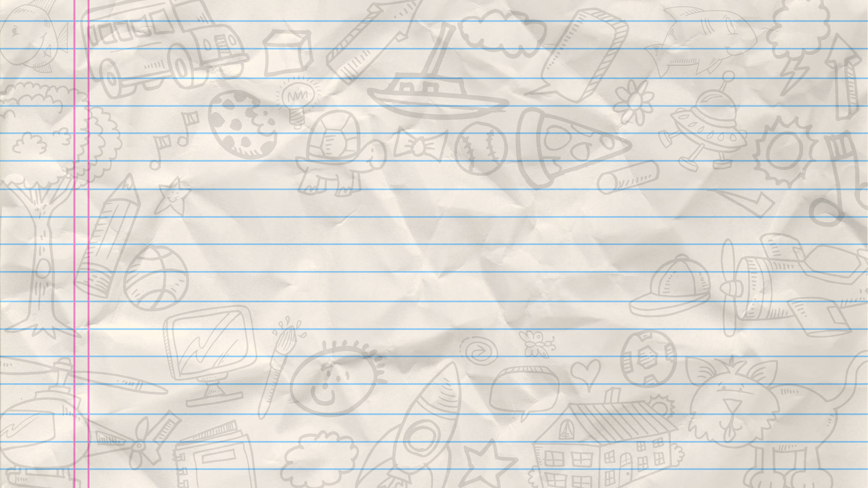
Amnon Had A Friend
2 Samuel 13:1-22

Slide 3
Who You Hang With Matters
God Cares About Who We Associate With
Exodus 34:11-16
Judges 2:1-15

Slide 4
Who You Hang With Matters
FRIENDS
CLOSER TO
GOD
FURTHER FROM GOD

Slide 5
Red Flags That Tell Us To Reevaluate Friendships
Proverbs 12:26
Proverbs 13:20
Proverbs 22:24-25

Slide 6
Red Flags That Tell Us To Reevaluate Friendships
When You Realize Their Core Values Are Radically Different

Slide 7
Red Flags That Tell Us To Reevaluate Friendships
When You Find Yourself Trying To Defend their Wrong Behavior

Slide 8
Red Flags That Tell Us To Reevaluate Friendships
When You Feel Pressure To Compromise

Slide 9
Red Flags That Tell Us To Reevaluate Friendships
When You Find Yourself Pretending To Be Someone Other Than Who You Know You Are

Slide 10
Red Flags That Tell Us To Reevaluate Friendships
When You Hope the People You Love and Care About Dont Find Out Who You Have Been With

Slide 11
What Kind of Friend Will You Be?

