Slide 1
Building Stronger
Homes
Avoiding Erosion at the Foundation of Marriage

Slide 2
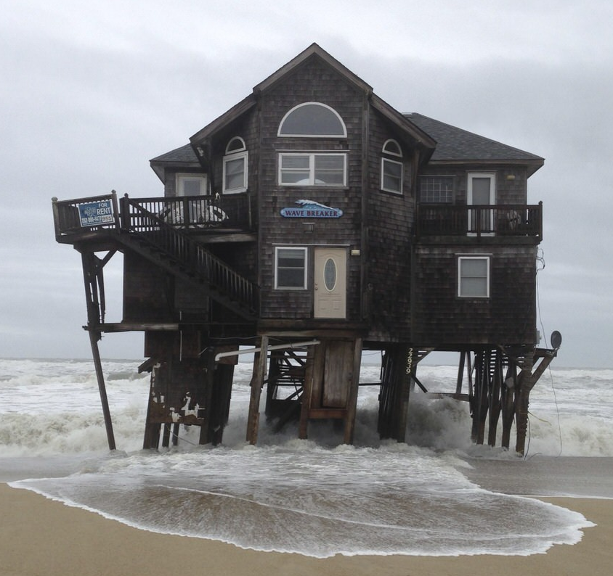
What Is Erosion?
WORK
“the process by which a surface is slowly worn away by an active force”
RESPONSIBILITIES
CULTURE
OTHER PEOPLE
HABITS
PASSING OF TIME

Slide 3
Sources of Marital Erosion
Revelation 2:2-5
Abandoning the Love You Had At First

Slide 4
Sources of Marital Erosion
Unintentional Familiarity
Revelation 2:4-5

Slide 5
Sources of Marital Erosion
Unrelenting Fatigue
Psalm 68:19

Slide 6
Sources of Marital Erosion
Undeniable Differences
Philippians 2:3-4
Different Backgrounds
Different Personalities
Different Roles

Slide 7
Sources of Marital Erosion
Unfocused Faith
Psalm 127:1
Genesis 18:19

Slide 8
Building Stronger
Homes
Avoiding Erosion at the Foundation of Marriage

