Slide 1
Building Stronger
Homes
Like Trees & Pillars

Slide 2
“The secret things belong to the Lord our God, but the things that are revealed belong to us and to our children forever, that we may do all the words of this law.” (Deut. 29:29)

Slide 3
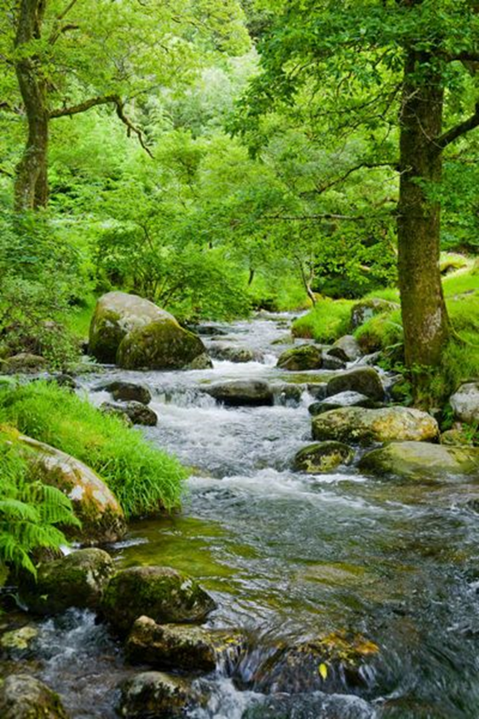
“May our sons in their youth be like plants full grown…
Psalm 1:1-3
Psalm 144:12

Slide 4
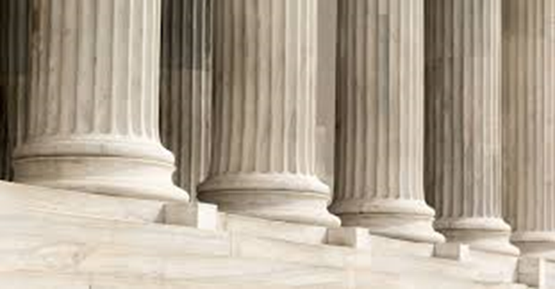
“our daughters like corner pillars cut for the structure of a palace.”
Psalm 1:1-3
1 Peter 2:4-5
Psalm 144:12

Slide 5
“…bind them around you neck; write them on the tablet of your heart.”
Proverbs 3:3

Slide 6
A Grasp of the Big Picture of the Bible
Acts 8:30-31

Slide 7
Respect for Authority
1 Peter 5:6

Slide 8
A Sincere Commitment to Personal Purity
1 Corinthians 6:19-20

Slide 9
Solid Reasons for Faith & Hope
1 Peter 3:15

Slide 10
The Ability to Make Wise Decisions
Proverbs
3:13-14

Slide 11
A God-First, Others-Next Way of Thinking
Matthew
22:37-39

Slide 12
A Developing Connection with Jesus
John 15:4-5

Slide 13
Building Stronger
Homes
Like Trees & Pillars

