Slide 1
The Musical Instrument Question

Slide 2
We Need To Have Convictions We Are Ready To Defend
Its Not My Job To Determine Who Is Saved
That Person Will Give An Account
So Will You

Slide 3
God Is Specific About Musical Worship In the Old Testament
2 Sam. 23:1-2 1 Chr. 25:1-3, 28:11-19
2 Chr. 7:6, 35:4,6, 12, 29:25-30
God Has Authorized Congregational Singing
God Has Not Approved the Instruments In Congregational Worship

Slide 4
God Is Specific About Musical Worship In the New Testament
1 Corinthians 14:13-26
Ephesians 5:15-21
Colossians 3:14-16
Hebrews 13:15
God Has Authorized Congregational Singing
God Has Not Approved the Instruments In Congregational Worship

Slide 5
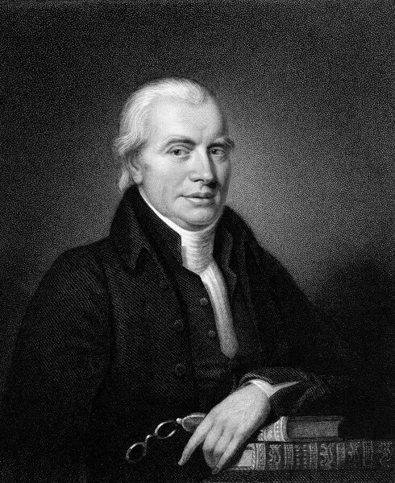
The Reformation Movement of the 16th Century Understood This
Presbyterian
Lutheran
Methodist
Baptist
God Has Authorized Congregational Singing
God Has Not Approved the Instruments In Congregational Worship

Slide 6
The Musical Instrument Question
Matthew 28:18-20

